Slide 1

HUBBALLI-DHARWAD SMART CITY
Presented by: ktc hub group 5
Tanushri
Lata
Khyati
Laxmi Guided by presenting for
mohammad tahir mirji sir sabyasachi sir

Slide 2

Introduction
Hubballi- Dharwad BRTS (also known as HDBRTS and Chigari) is a bus rapid transit system built to serve the twin cities of Hubli and Dharwad. HDBRTS if funded by joint collaboration of the World Bank, the Government of Karnataka, NWKRTC, and Ministry of Housing and Urban Affairs(MHUA).

Slide 3
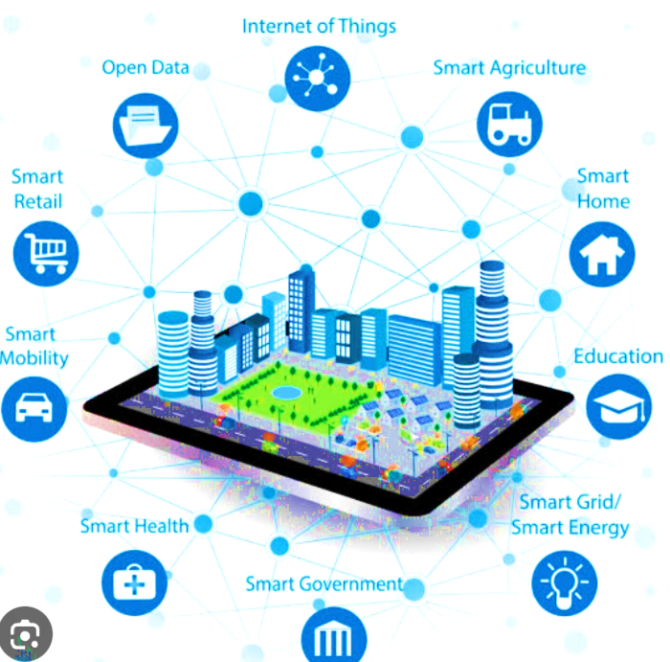
What is a smart city
A smart city is a technologically modern urban area that uses different types of electronic methods and sensors to collect specific data. Information gained from that data is used to manage assets, resources and services efficiently; in return, that data is used to improve operations across the city.

Slide 4


Slide 5
External factor
Geographic
Geographic factors that may affect the Bus Rapid Transit System (BRTS) in Hubli include the city's topography, road infrastructure, and the location of major population centers. For example, if the city has steep hills or narrow roads, it may be more difficult to construct dedicated bus lanes. Similarly, if the city's population is concentrated in certain areas, it may be more challenging to design a BRTS system that effectively serves all neighborhoods.

Slide 6
Logistics
Logistics factors that may affect the Bus Rapid Transit System (BRTS) in Hubli include the availability of buses, fuel, and maintenance resources. If there are not enough buses or fuel to operate the BRTS system, then it may not be able to meet demand. Similarly, if there are not enough resources to maintain the buses, then the system may be more prone to breakdowns and delays. Another logistic factor is the availability of trained personnel to operate and maintain the BRTS system

Slide 7
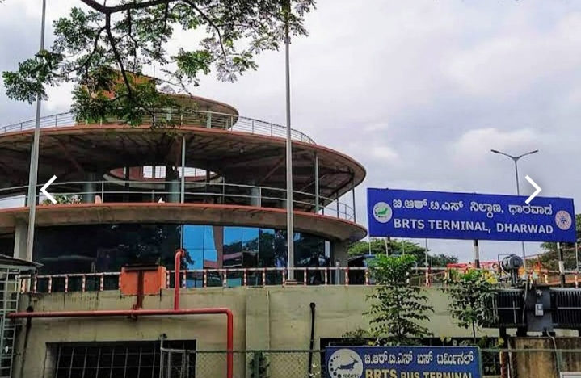
Internal factors
IT Infrastructure
Internal factors that can affect the IT infrastructure of the Bus Rapid Transit System (BRTS) in Hubli include the quality of hardware and software used, the reliability of the network infrastructure, the availability of skilled personnel to manage and maintain the system, and the security of the system. If the hardware and software used are outdated or unreliable, this can affect the performance of the system. Similarly, if the network infrastructure is not reliable, then the BRTS system may experience downtime or delays. The availability of skilled personnel to manage and maintain the system is also important to ensure that any issues are resolved quickly. Finally, ensuring the security of the system is important to prevent unauthorized access and ensure the privacy of user data.

Slide 8
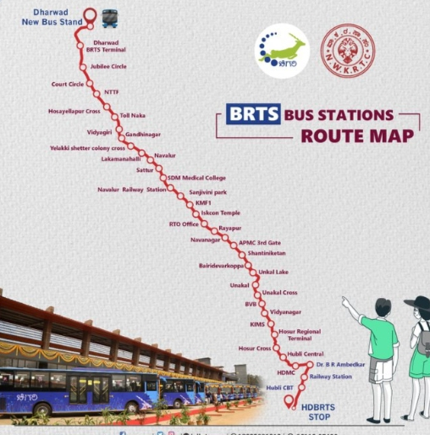
Mix Infrastructure-Manufacturing
Internal factors that can affect the manufacturing and maintenance of the Bus Rapid Transit System (BRTS) in Hubli are the quality of the manufacturing process and the availability of skilled personnel to carry out maintenance and repairs. If the manufacturing process is of high quality, then the BRTS system will be less prone to breakdowns and require less frequent repairs. Similarly, if there are enough skilled personnel to carry out maintenance and repairs, then any issues can be resolved quickly, reducing downtime and delays.

Slide 9
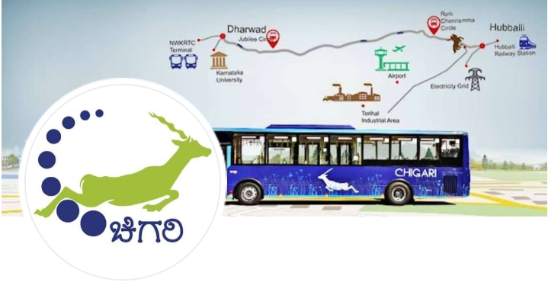
Services
Two internal factors that can affect the services provided by the Bus Rapid Transit System (BRTS) in Hubli are the reliability and frequency of bus services, and the quality of customer service provided. If the bus services are reliable and frequent, this can improve the user experience and encourage more people to use the system. Similarly, if the customer service provided is of high quality, this can help to resolve any issues that users may have and improve their overall satisfaction with the system

Slide 10
Energy
Sustainable energy for smart city
The energy sustainability of the Bus Rapid Transit System (BRTS) in Hubli can be affected by several factors, including the type of fuel used to power the buses, the efficiency of the buses and the overall system, and the use of renewable energy sources. Using alternative fuels such as biodiesel or compressed natural gas (CNG) can reduce the environmental impact of the system and improve its sustainability. Similarly, ensuring that the buses and the system as a whole are designed to be as energy-efficient as possible can help to reduce energy consumption and costs. Finally, incorporating renewable energy sources such as solar or wind power into the system can further improve its sustainability.

Slide 11
Finance
Source of income to become sustainable
To become financially sustainable, the Bus Rapid Transit System (BRTS) in Hubli can explore several sources of income, including fare revenues, advertising and sponsorship, and public-private partnerships. Maximizing fare revenues by increasing ridership and ensuring that fares are set at an appropriate level can help to ensure the financial viability of the system. Similarly, generating revenue through advertising and sponsorship can help to offset costs and improve the system's financial sustainability. Finally, partnering with private companies or other organizations to provide additional services or infrastructure can help to generate additional income and improve the long-term financial sustainability of the BRTS system in Hubli

Slide 12


Slide 13
Conclusion
An effective way to transport passengers must be provided.
Implementing the brts system would enhance the LOS on the links and intersection.
For the long term, if there where no better improvement for the infrastructure in addition to public transportation, the traffic congestions will get worse than it has been.

Slide 14


